Slide 1

Wildlife Conflict and Movement Predictor Using AI
Internship Report · School of Computer Science and Engineering · IILM University, Greater Noida, U.P.
B.TECH CSE · 2026–27
MARS INTERNSHIP · JUNE–JULY 2026

Slide 2

Report Overview
Student
Internship Details
Abhishek Kumar Mishra
Roll No.: 25SCS1003001223
Batch: 2026–27 · Section: 2CSE31
Organization: MARS Internship
Mode: Online
Period: 1 June 2026 – 15 July 2026
Project Coverage
10 National Parks
Primary Users: Rural communities & park rangers
Type: Web-based wildlife monitoring platform
The student declares that this report presents original internship work completed in partial fulfillment of the B.Tech CSE degree at IILM University. Acknowledgements are extended to IILM University, MARS Internship, teammates, and family for their support throughout the internship period.

Slide 3
Organization Profile & Certificate
MARS – Centre for Sustainable Community Development
Certificate of Completion
Reference No.: MARS/INT-CERT/2026/055
Date of Issue: July 31, 2026
This certifies that Abhishek Kumar Mishra successfully completed an internship with MARS from June 1 to July 15, 2026, demonstrating dedication, a strong learning attitude, and genuine commitment to sustainability and community service.
"Sustainability is not a destination but a continuing journey."
Dr. Manish Prateek, Director, MARS
MARS Internship was the organization through which this internship was conducted. The program involved collaborative, remote project development by a team of students focused on building a working software project around the wildlife-conflict problem. The work environment emphasized project completion, collaboration, implementation, and iterative improvement — providing exposure to taking a project idea and turning it into an integrated application with multiple user-facing and data-oriented modules.

Slide 4

Problem Statement
Human–wildlife conflict becomes difficult to manage when information about animal movement, sightings, conflict incidents, and risk areas is scattered, delayed, or difficult to interpret. Rural communities may not know which areas currently have a higher likelihood of wildlife movement, while park rangers may need to examine different sources of information before deciding where attention should be concentrated.
Scattered Information
Dynamic Data Challenge
Need for Integration
Wildlife movement, sightings, and conflict data exist across multiple disconnected sources, making timely decision-making difficult for both communities and rangers.
Wildlife information changes over time. New observations and incident records from national parks require a platform that can be practically updated without rebuilding the entire system.
An integrated platform combining wildlife movement, incident reporting, analytics, data management, and AI-assisted risk information in one interface is needed to support awareness, monitoring, and preventive action.

Slide 5
Project Objectives
The main objectives were to create a centralized and usable platform for monitoring wildlife-related information and supporting responses to potential conflict situations.
01
02
Web-Based Interface
Map-Based View
Provide a web-based interface for accessing wildlife movement and conflict-related information.
Allow users to view wildlife activity and relevant locations through a map-based interface.
03
04
Analytics
Incident Reporting
Provide analytics that help users understand sightings, threat levels, and activity patterns.
Provide a structured mechanism for reporting wildlife sightings or conflict incidents.
05
06
AI Risk Information
Dataset Management
Provide AI-assisted risk information to indicate periods or areas that may require greater attention.
Allow new datasets from national parks to be uploaded and managed through the system.
07
08
Multi-Park Support
Community & Ranger Interface
Support multiple national parks through a park-selection mechanism.
Create a practical interface that can support both community awareness and ranger decision-making.

Slide 6









Scope of the Project
The project covers the development of a web platform bringing together several information and decision-support functions related to wildlife movement and human–wildlife conflict, demonstrated with information from ten national parks.
Wildlife Monitoring
Conflict Awareness
Viewing animal movement and location information through the live map interface.
Displaying conflict-related zones, incidents, and risk information.
Incident Reporting
Analytics
Recording wildlife sightings or conflict incidents with relevant details.
Viewing statistical and visual information about wildlife activity and threat patterns.
AI Support
Data Management
Presenting risk-prediction information and recommended attention/action areas.
Uploading and managing new datasets received from national parks.
Multi-Park Support
User Support
Switching between supported national parks within the platform.
Providing information that can assist rural communities and park rangers.
Out of Scope: The system is not presented as a replacement for official wildlife authorities, field verification, or emergency response systems.

Slide 7
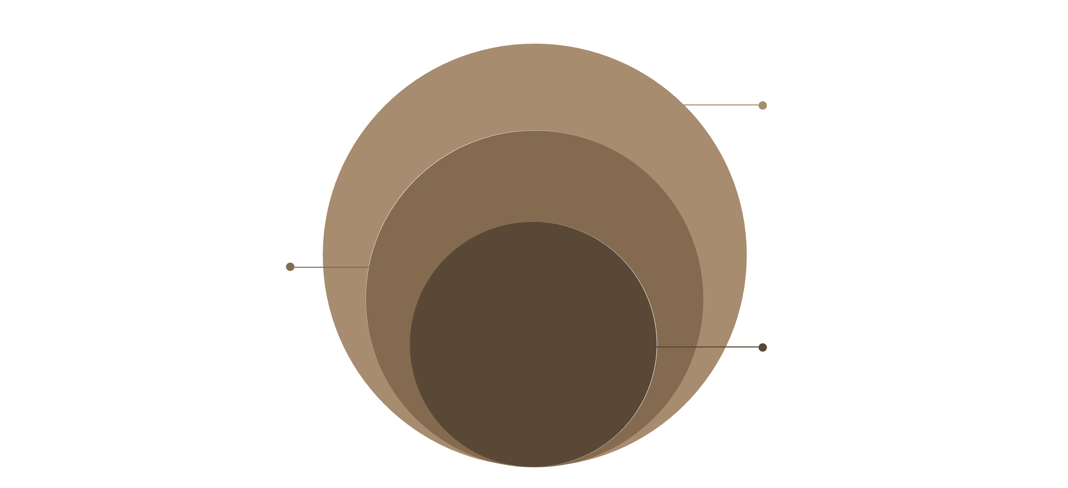
Technologies & System Architecture
Technologies Used
System Architecture
JavaScript
Primary programming language for the web application
The system follows a modular web-application structure. Rural users and rangers interact with the frontend interface, which communicates with backend services. The backend works with stored datasets and application data, while the AI-oriented risk component operates as a decision-support layer. MongoDB provides persistent storage, and park datasets form an important input — new information can be uploaded and managed without rebuilding the complete interface. The park-switching mechanism allows users to select the required park and view corresponding information.
MongoDB
Storing and managing application data
Web Frontend
Dashboards, maps, forms, analytics, and user-facing interfaces
Backend Services
Application-side processing and data operations
AI Risk Component
Wildlife risk information and prediction outputs
Dataset Management
Uploading and maintaining park datasets
AI-Assisted Tooling
Accelerating implementation and iteration during development
Backend & Data
APIs, services, MongoDB and park datasets
Web Application
Live map, analytics, reports, AI predictor
Users
Rural users and park rangers
The architecture keeps the different responsibilities of the platform organized while allowing new park data to be introduced over time through the same application structure.

Slide 8
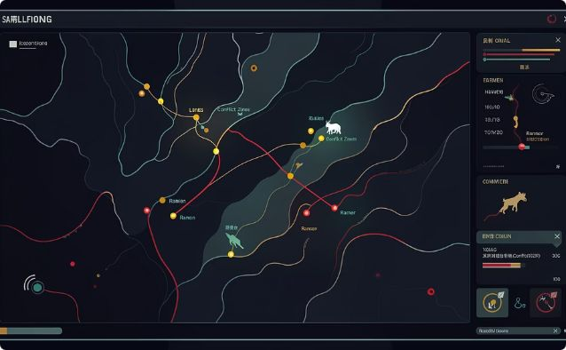
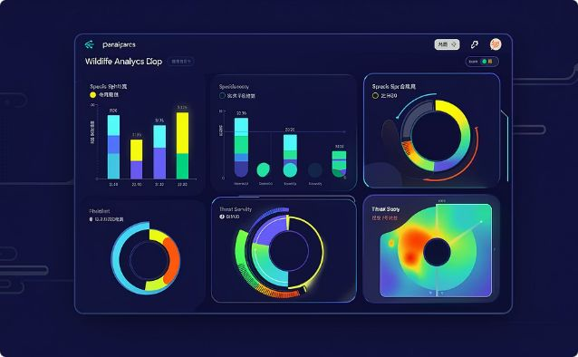
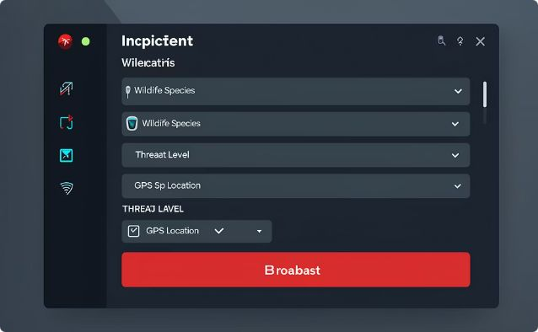
Platform Modules: Map, Analytics & Reporting
Live Map Dashboard
Analytics Module
Incident Reporting
Provides a map-based view of wildlife locations, movement-related information, park boundaries, and conflict/risk areas. Combines park information with movement indicators and conflict-related zones to make spatial patterns easier to understand than raw records. Rangers can identify locations requiring attention; community users can understand areas of wildlife activity.
Converts stored information into visual summaries including wildlife sighting frequency by species, threat severity breakdown, and temporal activity heatmaps. Visualizations help users identify trends and compare the relative importance of different categories of information. Raw datasets can be difficult to interpret quickly; summarized analytics support faster pattern recognition.
Provides a structured, form-based mechanism for recording wildlife sightings and conflict incidents. Standardizes submitted information so incident records can be reviewed alongside other wildlife data. When new records are added, they support monitoring and later analysis, subject to the quality and completeness of the submitted information.

Slide 9

AI Risk Prediction & Dataset Management
AI Risk Predictor
Dataset Management
The decision-support component presents risk-oriented information to help users understand when and where wildlife conflict may require increased attention. The demonstrated interface includes:
Addresses the changing nature of wildlife information. National parks may provide new datasets as additional observations become available. The system provides an interface for uploading and managing datasets without requiring developers to manually edit the application.
Hourly and monthly risk information
Conflict-type breakdowns and hotspot data
Movement direction and activity windows
Suggested ranger actions
Species-specific profiles (e.g., Asian Elephant: est. population 1,940, risk index 85, HIGH threat level)
Drag-and-drop dataset upload
Dataset preview and validation
Version tracking and upload history
Rollback to previous datasets
Sample template downloads
Output should be interpreted as predictive or advisory information, not as a guaranteed statement of future animal behavior.
This makes the data-management layer an important part of the project's long-term usability.
The platform supports 10 national parks through a park-selection mechanism, allowing the same application structure to be reused across different wildlife regions without rebuilding for each location.

Slide 10





Expected Outcomes & Conclusion
Centralized Information
Improved Awareness
Wildlife movement, incident, analytics, and risk information presented through one unified platform.
Users obtain a clearer picture of wildlife activity and conflict-prone areas for both communities and rangers.
Ranger & Community Support
Data Updatability & Scalability
Rangers use maps, analytics, and risk data for planning; rural communities access information about potential wildlife activity.
New park datasets introduced through Dataset Management; the same platform structure supports multiple national parks with future extensibility.
Internship Experience
Submission Notes
The project provided experience in participating in a complete software project — requiring practical coordination, implementation, modification, debugging, and integration within a team. The student's primary contribution was in backend development and major frontend modifications, as part of a collaborative team effort.
Per university instructions, the Internship Report PDF, Internship Presentation PDF, and Internship Completion Certificate PDF are to be included in the public GitHub repository used for evaluation. The scanned MARS certificate and any official communication mail should be attached before final submission.

